Slide 2
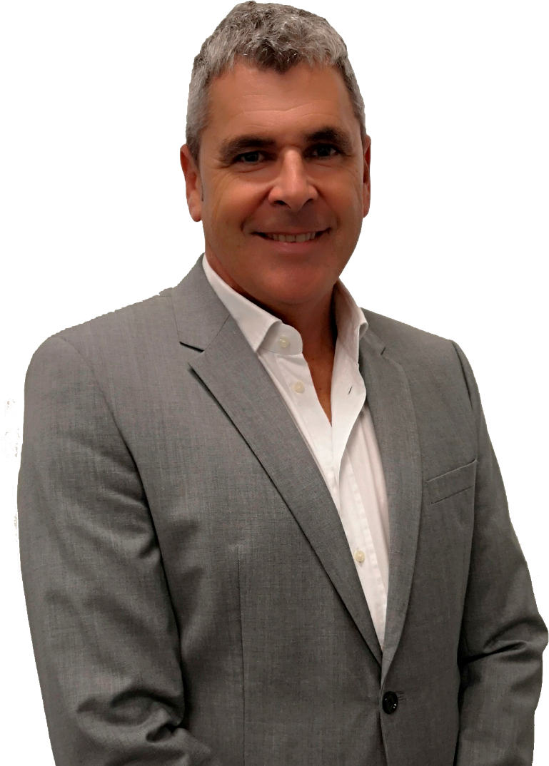
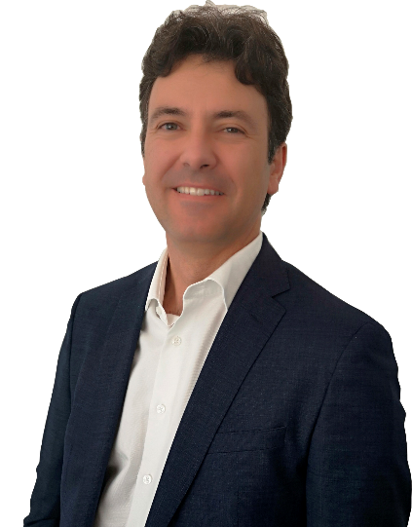
The ACME in the industry
The Aerospace and Defence market recently defined by the great and known company mergers is experiencing, although waiting for new programmes, a significant growth thanks to the increase of the defence spending of some of the world key countries.
In this context main OEMs make their CORE/CONTEXT analysis to identify areas and domains that provide them with differentiation and a strategy for its Supply Chain.
In this sense Airbus DS launches ACME, a programme to externalize part of its engineering pursuing to benefit from multicompetence teams and a deliverables oriented management. For the ALTRAN Group, ACME is undoubtedly one of the largest contract we have ever faced worldwide. In terms of volume, relevance of the activity and because it mainly encompasses two very important countries as Spain and Germany, ACME is a priority challenge for us and as such we dedicate a great effort to offer the service Airbus DS requires at all times.
Proof of this is also our R&D investments, completely aligned towards developing talent for the market as well as new technologies that could be applied, for example within this contract.
ALFONSO MARTINEZ
Aerospace Industry Senior VicePresident
ALTRAN´s strategy at an Airbus DS level
As many of our clients Airbus DS is facing challenges related Time-to-Market acceleration, be more innovative and digital as well as cultural changes to foster cooperation and build One Engineering organization. Our own strategy plan, High Road 2022 is designed to support our key clients as Airbus DS to achieve these goals.
Engineering domain is a cornerstone to face these challenges, and ACME the vehicle for Airbus DS partners to bring value in coming critical years. In this sense we highlight three axes of the Altran´s strategy for ACME:
First, keep improving our current performances based on our deep knowledge on Airbus DS products and services.
Second, contribute to foster transnational cooperation using our large international footprint.
Third, bring value through our high-value solutions based, for instead, on Analytics, IoT or Innovation and Design.
In short, we feel challenged and committed with Airbus DS goals for the coming years and are highly motivated to contribute to achieve these goals through ACME framework.
ALBERTO REGUERA
Global Account Manager for Airbus DS
ALBERTO REGUERA
Global Account Manager for Airbus DS

Slide 3
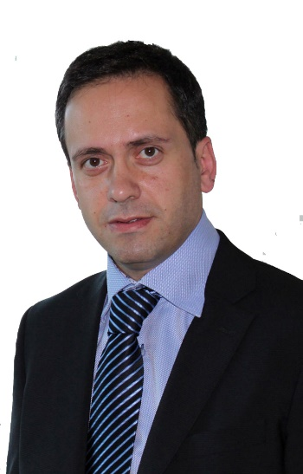

The main challenages ACME poses
ACME is a new way of working, more deliverable orientated, with a greater focus on objectives and results and with a commitment to quality that will be permanently measured with the corresponding indicators. Additionally, ACME will consolidate and reinforce the steps being taken towards working off-site and a greater autonomy on the supplier´s side. All of this will undoubtedly accentuate the added value offered by each company, demanding excellence in every step we take.
In this setting, the main challenges we face are organizational and change management. Working with WUs that are more focused on service, managing customer needs from an international level and finding more autonomous delivery modes are aspects that we have been working on for many years in Airbus Operations for example and from which we hope to apply our experience, lessons learned and good practices to ACME.
On the other hand, another challenge that we face is in the search for talent. In many cases the market is not capable of providing the specific knowledge required to meet the demand. ALTRAN has been working for a long time now with Internships, R&D and other initiatives in an attempt to mitigate this effect
LUIS JAVIER CODÓN
Managing director Aerospace & Defence division
Our stategy on Alliances & Partnerships
Alliances & partnerships are key to serve our global and key accounts and are fully embedded into Altran´s strategy and supply chain.
As every customer has different needs Altran studies these in a careful way and answers with a customized approach for each client
We work with niche suppliers as well as capacity providers to complement our portfolio or domain know how to react on market needs and peaks and to enable End to End service offerings
In general, we only partner with companies that enrich our portfolio and boost our performance.
For the ACME we concentrate on established players that are working long-term in the aerospace and defence field to underline our ambition to bring value to Airbus DS and to support transformation as well as business continuity. With most of our partners we already work in MultiCo and MultiCeco or other environment for several years in a trustful way.
ALEX BÖDCHER
Managing director Aerospace & Defence division

Slide 4
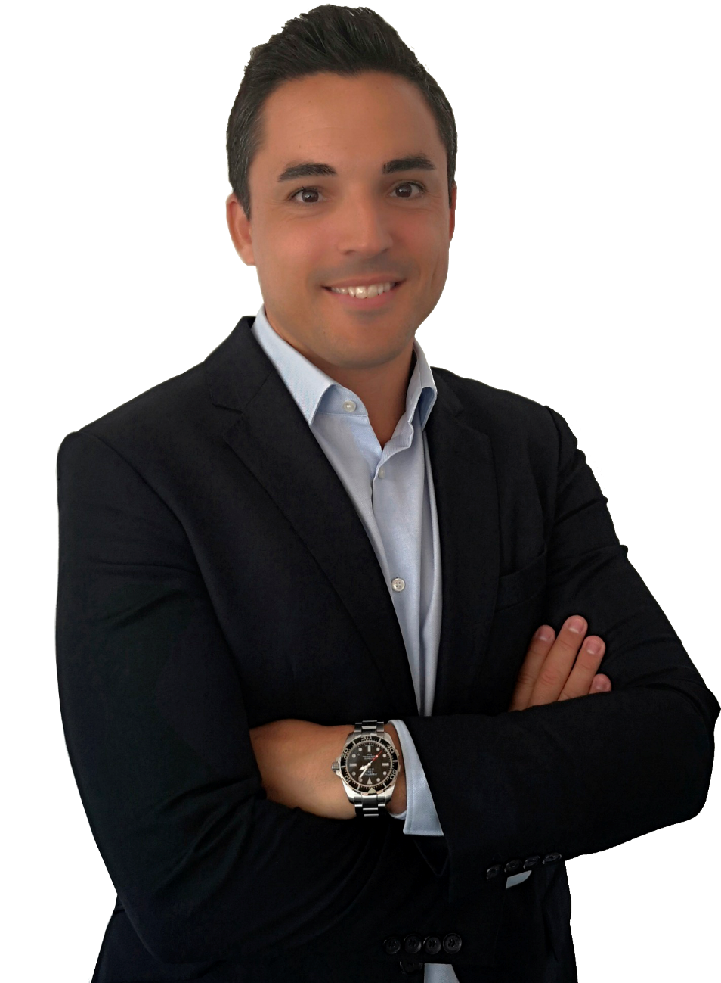
ALTRAN´s main objectives for this new period
First Deliver, this is the first and main goal of ALTRAN for this new contract. Everything else is a strategy or means to achieve it. We can never compromise this key parameter.
Beyond this we work towards offering more complete solutions, End to End, so that we consolidate the trust of our current customers, extend our footprint where we are not today and improve our on-going services. .For this we work every day to create customized solutions such as Critical SW, Cybersecurity and consolidate others such as the most established of System Integration or SW development or the most recent in Analytics or Innovation & Design.
We are a very large company, with great capacity, that structures its moving parts in such a way as to offer real added value to our customers. A great machine that on the other hand only sustains itself with GROWTH and therefore must be and will be another key objective of ALTRAN within the ACME.
In short, we want to become the principal and preferred partner for any Airbus DS activity within ACME.
GERMAN BARBERO
Business Director Spain
What ALTRAN offers for the ACME
If I had to define aspects in which we believe and that I consider characterize us and therefore will be offered to Airbus DS in the coming years, they are commitment, flexibility and professionalism. ALTRAN is aligned with Airbus DS in the strategy it sets at all times.
We offer our experience for transnational collaborations, our extensive portfolio of expertise with our WCCs such as analytics or Innovation & Design, our skills development initiatives, and why not our best practices and lessons learnt regarding WUs catalogue management.
In Addition our Client knowledge allows us to be another defender of the Golden Rules, building fruitful and trustworthy relationships around Ethics and Compliance
JUAN BETHANCOUR
Business Director Germany
ALBERTO REGUERA
Global Account Manager for Airbus DS

Slide 5
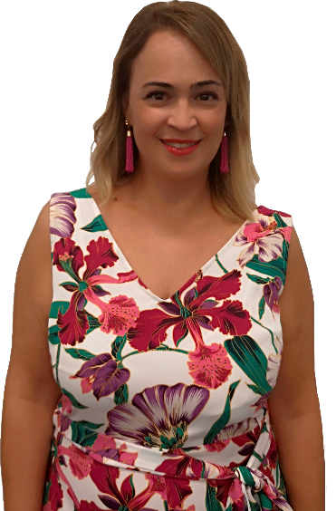
Our footprint after this period
As head of the Operations team, I would firstly want to look at the KPIs of each ACME service. I would like to see that each one is at its maximum potential, which means that our "First Deliver" goal has been achieved on time and with quality.
I would also like to see industrialization in our processes in order to be more efficient, so as to work as a real "Deliverable Factory" with greater autonomy and less need for client involvement. We have been working on this concept for some time now in the areas where it has been possible, trying to apply these practices for other clients such as Airbus Operations.
And of course I would love to see motivated teams that are continually striving for improvement, which characterizes the entire ALTRAN team.
EVA CESTEROS
Operations Director
ALBERTO REGUERA
Global Account Manager for Airbus DS

Slide 6



Airbus DS Catalogue Multi Engineering

